Slide 1
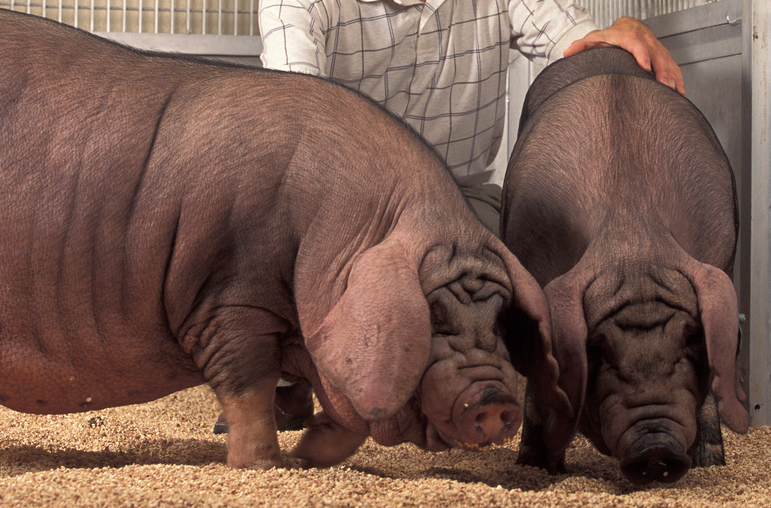
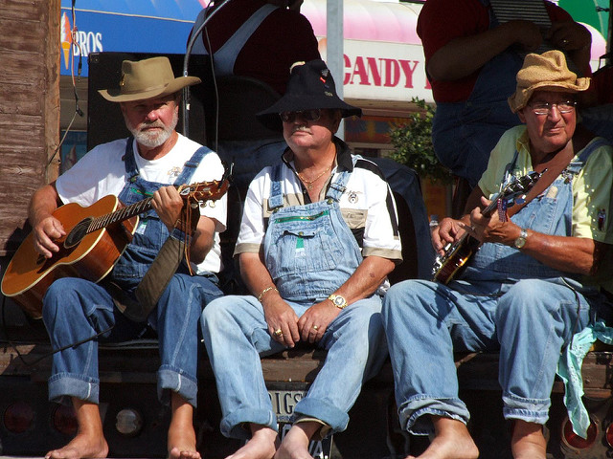
(PFARS)Pig Farmers Automated Resort Software
This Photo by Unknown author is licensed under CC BY-SA.
This Photo by Unknown author is licensed under CC BY-NC-ND.
By Alex Lundin, Geet Babaria, Justin Horak

Slide 2
PFARS Introduction
PFARS connects IoT devices to specific users and sends requests to resort staff which gives the ultimate personal, relaxing, user experience
Each user sets their own personal settings and requests, these settings are then saved to the PFARS database, and are retrieved prior to arrival
PFARS is the backbone of the Pig Farmer Resort Domicile System
PFARS gives the ultimate user experience by interacting with numerous smart devices

Slide 3
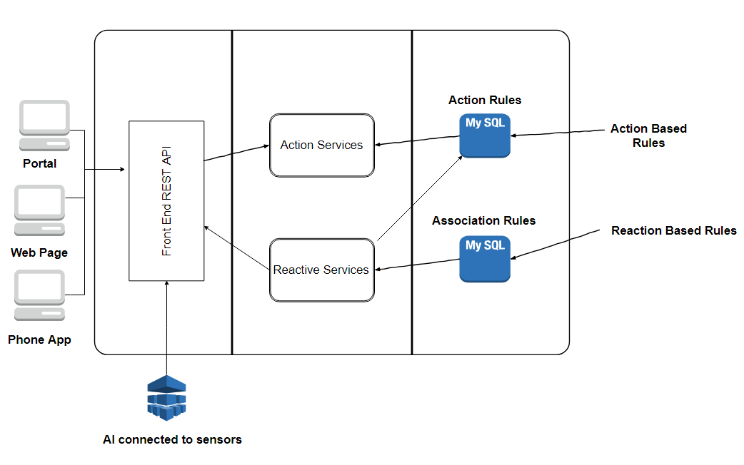
PFARS Architecture
PFARS is a standard web-based architecture that uses a python-based driver, css, and html5 for cross-platform support. PFARS utilizes a web application source for both Android and iOS applications.

Slide 4
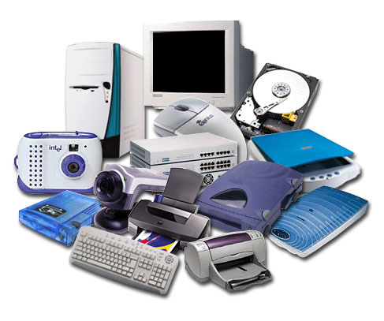
Hardware
Smart Devices
Sensors
Cameras
Smart Locks
RFID scanners
Microphone
Domicile Hub
Raspberry pi v3
Retroflag Raspberry pi v3 case
Centralized Hub
2U 4Node 24 Bay Xeon Scalable
This Photo by Unknown author is licensed under CC BY-NC.

Slide 5

Software
Domoticz
Use: Linux Integration for Automation Tools Software
Version: 4.9700
Source: https://domoticz.com/downloads/
Epiphany
Use: Web to Application conversion Software
Version: 3.29.3
Source: https://www.ubuntu.com/downloads
Ubuntu Server
Use: Server Sofware
Version 18.04 LTS
Source: https://www.ubuntu.com/downloads
Python
Use: Driver Software Language
Version: 3.7.1
Source: https://www.python.org/downloads/
MySQL
Use: Database Software
Version: 8.0.13
Source: https://dev.mysql.com/downloads/
This Photo by Unknown author is licensed under CC BY-SA.

Slide 6
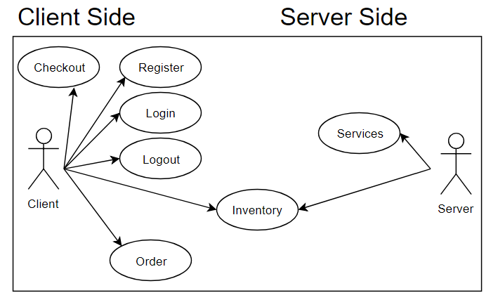
Use Case View
Client selects room Client registers PFARS account Client chooses Settings Client checkout Data is sent to database Services are setup at resort according to preferences and requests

Slide 7
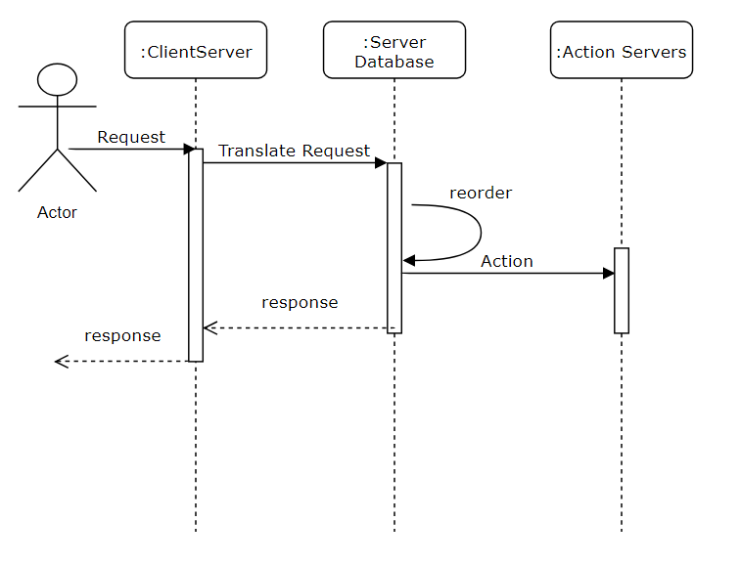
Process View
Process view shows the sequence of events in the PFARS system using Actor/Request and shows interaction between components in chronological order.

Slide 8
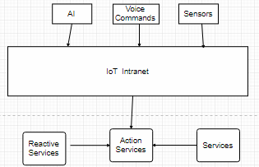
Logical View
The PFARS logical view shows the customer query request, and how the request translates into interactions between the input devices to the server

Slide 9
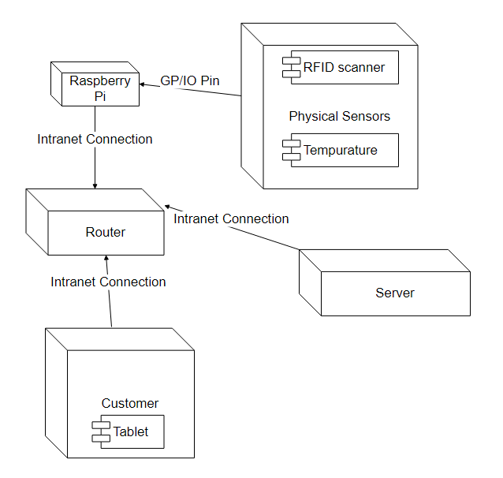
Physical View
PFARS complete physical mapping of entire system
Sensors connect to Raspberry Pi
Raspberry Pi connects to internet
Customer controls from device to internet
Data is transmitted via internet

Slide 10
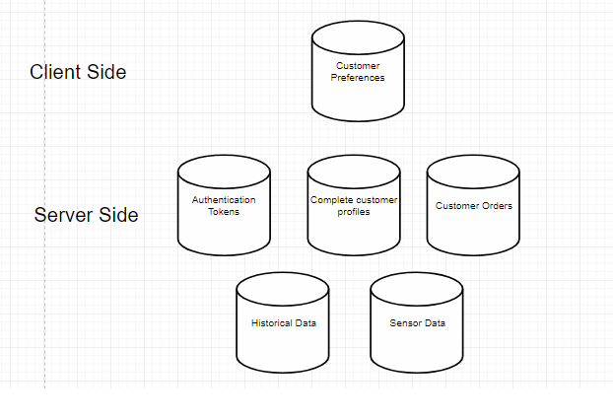
Data View
Client only has access to preference settings
Server has all data pertaining to system

Slide 11
PFARS Project Summary
The first presentation from our Stakeholder, Gordon Arnold, gave us an opportunity to elicit what the system must do.
During phase I of the project we documented the functional and non-functional requirements.
During phase II, we refined the functional and non-functional items and created a new Software Architecture Document.
The SAD further extended the representation of the initial requirements into a more comprehensive format the gives a holistic representation of the final deliverable.

Slide 12
References
(n.d.). Retrieved November 27, 2018, from https://www.serversdirect.com/servers/whitebox-open
Empowering the smart home. (n.d.). Retrieved November 27, 2018, from https://www.openhab.org/
Foundation, R. P. (n.d.). Teach, Learn, and Make with Raspberry Pi. Retrieved November 27, 2018, from https://www.raspberrypi.org/
Stringfellow, A. (2018, June 25). What is Web Application Architecture? How It Works, Trends, Best Practices and More. Retrieved November 27, 2018, from https://stackify.com/web-application-architecture/

